Slide 1
Software Development Life Cycle (SDLC)
Prepared By ~Abhishek Rautela

Slide 2
Outline
What is SDLC ?
Various SDLC Models
Waterfall
V Shaped Model
Protyping
RAD
Incremental
Spiral
SLC Stage Description and Work Products

Slide 3
Software Development Life Cycle (SDLC)
A framework that describes the activities performed at each stage of a software development project.
SDLC stands for
Software Development Life Cycle
First, SDLC is a Life Cycle.
All software have a life cycle or a series of stages they naturally undergo.
The number and name of the stages varies, but the primary stages are conception, development, maturity and decline.
The software development life cycle (SDLC) therefore, refers to the development stage of the software’s life cycle.

Slide 4
Software Life Cycle (SLC) Decomposition
The Software Life Cycle process comprises systems analysis, design, development, testing, delivery, implementation and maintenance of a software system. The Process Decomposition diagram of Software Life Cycle Process is shown below. SLC=SDLC + SMLC (Software Maintenance Life Cycle)

Slide 5
SDLC MODELS

Slide 6
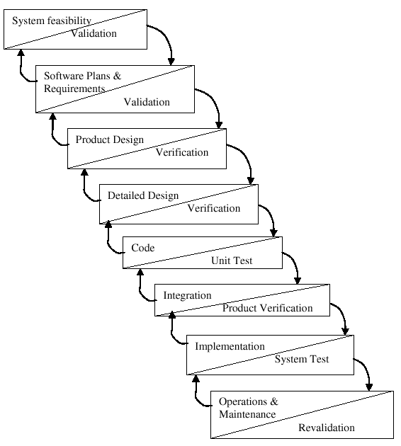
Waterfall Model
Requirements – defines needed information, function, behavior, performance and interfaces.
Design – data structures, software architecture, interface representations, algorithmic details.
Implementation – source code, database, user documentation, testing.

Slide 7
Waterfall Strengths
Easy to understand, easy to use
Provides structure to inexperienced staff
Milestones are well understood
Sets requirements stability
Good for management control (plan, staff, track)
Works well when quality is more important than cost or schedule

Slide 8
Waterfall Deficiencies
All requirements must be known upfront
Deliverables created for each phase are considered frozen – inhibits flexibility
Can give a false impression of progress
Does not reflect problem-solving nature of software development – iterations of phases
Integration is one big bang at the end
Little opportunity for customer to preview the system (until it may be too late)

Slide 9
When to use the Waterfall Model
Requirements are very well known
Product definition is stable
Technology is understood
New version of an existing product
Porting an existing product to a new platform.

Slide 10
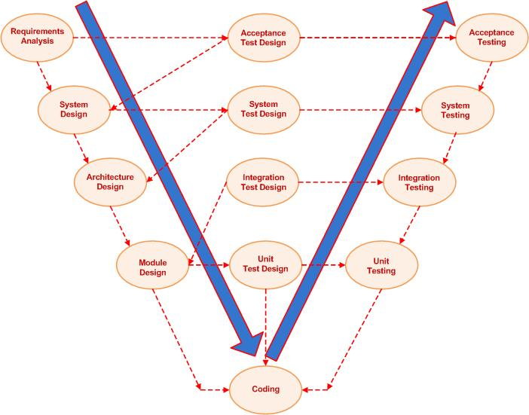
V-Shaped SDLC Model
A variant of the Waterfall that emphasizes the verification and validation of the product.
Testing of the product is planned in parallel with a corresponding phase of development

Slide 11
V-Shaped Steps
Project and Requirements Planning – allocate resources
Product Requirements and Specification Analysis – complete specification of the software system
Architecture or High-Level Design – defines how software functions fulfill the design
Detailed Design – develop algorithms for each architectural component
Production, operation and maintenance – provide for enhancement and corrections
System and acceptance testing – check the entire software system in its environment
Integration and Testing – check that modules interconnect correctly
Unit testing – check that each module acts as expected
Coding – transform algorithms into software

Slide 12
V-Shaped Strengths
Emphasize planning for verification and validation of the product in early stages of product development
Each deliverable must be testable
Project management can track progress by milestones
Easy to use

Slide 13
V-Shaped Weaknesses
Does not easily handle concurrent events
Does not handle iterations or phases
Does not easily handle dynamic changes in requirements
Does not contain risk analysis activities

Slide 14
When to use the V-Shaped Model
Excellent choice for systems requiring high reliability – hospital patient control applications
All requirements are known up-front
When it can be modified to handle changing requirements beyond analysis phase
Solution and technology are known

Slide 15
Prototyping Model
Coding

Slide 16
Structured Evolutionary Prototyping Model
Developers build a prototype during the requirements phase
Prototype is evaluated by end users
Users give corrective feedback
Developers further refine the prototype
When the user is satisfied, the prototype code is brought up to the standards needed for a final product.

Slide 17
Structured Evolutionary Prototyping Strengths
Customers can “see” the system requirements as they are being gathered
Developers learn from customers
A more accurate end product
Unexpected requirements accommodated
Allows for flexible design and development
Steady, visible signs of progress produced
Interaction with the prototype stimulates awareness of additional needed functionality

Slide 18
Structured Evolutionary Prototyping Weaknesses
Tendency to abandon structured program development for “code-and-fix” development
Bad reputation for “quick-and-dirty” methods
Overall maintainability may be overlooked
The customer may want the prototype delivered.
Process may continue forever (scope creep)

Slide 19
When to use Structured Evolutionary Prototyping
Requirements are unstable or have to be clarified
As the requirements clarification stage of a waterfall model
Develop user interfaces
Short-lived demonstrations
New, original development
With the analysis and design portions of object-oriented development

Slide 20
Rapid Application Model (RAD)
Requirements planning phase (a workshop utilizing structured discussion of business problems)
User description phase – automated tools capture information from users
Construction phase – productivity tools, such as code generators, screen generators, etc. inside a time-box. (“Do until done”)
Cutover phase -- installation of the system, user acceptance testing and user training

Slide 21
RAD Strengths
Reduced cycle time and improved productivity with fewer people means lower costs
Time-box approach mitigates cost and schedule risk
Customer involved throughout the complete cycle minimizes risk of not achieving customer satisfaction and business needs
Focus moves from documentation to code
Uses modeling concepts to capture information about business, data, and processes.

Slide 22
RAD Weaknesses
Accelerated development process must give quick responses to the user
Risk of never achieving closure
Hard to use with legacy systems
Requires a system that can be modularized
Developers and customers must be committed to rapid-fire activities in an abbreviated time frame.

Slide 23
When to use RAD
Reasonably well-known requirements
User involved throughout the life cycle
Project can be time-boxed
Functionality delivered in increments
High performance not required
Low technical risks
System can be modularized

Slide 24
Incremental Model
Construct a partial implementation of a total system
Then slowly add increased functionality
The incremental model prioritizes requirements of the system and then implements them in groups.
Each subsequent release of the system adds function to the previous release, until all designed functionality has been implemented.

Slide 25
Incremental Model Strengths
Develop high-risk or major functions first
Each release delivers an operational product
Customer can respond to each build
Uses “divide and conquer” breakdown of tasks
Lowers initial delivery cost
Initial product delivery is faster
Customers get important functionality early
Risk of changing requirements is reduced

Slide 26
Incremental Model Weaknesses
Requires good planning and design
Requires early definition of a complete and fully functional system to allow for the definition of increments
Well-defined module interfaces are required (some will be developed long before others)
Total cost of the complete system is not lower

Slide 27
When to use the Incremental Model
Risk, funding, schedule, program complexity, or need for early realization of benefits.
Most of the requirements are known up-front but are expected to evolve over time
A need to get basic functionality to the market early
On projects which have lengthy development schedules
On a project with new technology

Slide 28
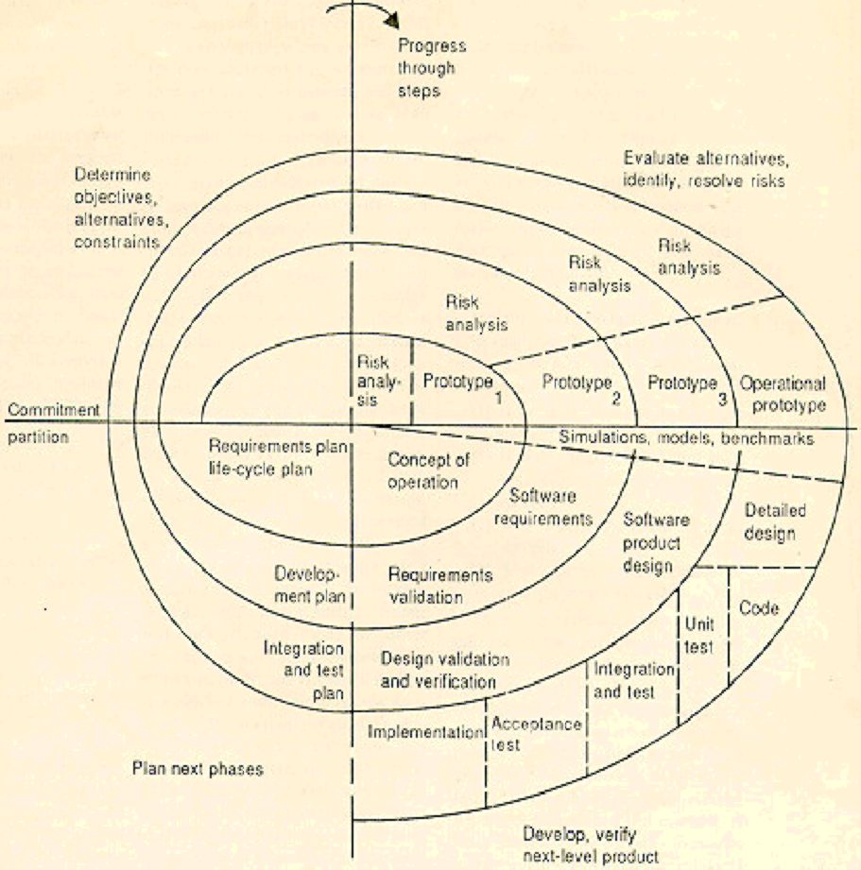
Spiral SDLC Model
Adds risk analysis, and 4gl RAD prototyping to the waterfall model
Each cycle involves the same sequence of steps as the waterfall process model

Slide 29
Spiral Quadrant Determine objectives, alternatives and constraints
Objectives: functionality, performance, hardware/software interface, critical success factors, etc.
Alternatives: build, reuse, buy, sub-contract, etc.
Constraints: cost, schedule, interface, etc.

Slide 30
Spiral Quadrant Evaluate alternatives, identify and resolve risks
Study alternatives relative to objectives and constraints
Identify risks (lack of experience, new technology, tight schedules, poor process, etc.
Resolve risks (evaluate if money could be lost by continuing system development

Slide 31
Spiral Quadrant Develop next-level product
Typical activites:
Create a design
Review design
Develop code
Inspect code
Test product

Slide 32
Spiral Quadrant Plan next phase
Typical activities
Develop project plan
Develop configuration management plan
Develop a test plan
Develop an installation plan

Slide 33
Spiral Model Strengths
Provides early indication of insurmountable risks, without much cost
Users see the system early because of rapid prototyping tools
Critical high-risk functions are developed first
The design does not have to be perfect
Users can be closely tied to all lifecycle steps
Early and frequent feedback from users
Cumulative costs assessed frequently

Slide 34
Spiral Model Weaknesses
Time spent for evaluating risks too large for small or low-risk projects
Time spent planning, resetting objectives, doing risk analysis and prototyping may be excessive
The model is complex
Risk assessment expertise is required
Spiral may continue indefinitely
Developers must be reassigned during non-development phase activities
May be hard to define objective, verifiable milestones that indicate readiness to proceed through the next iteration

Slide 35
When to use Spiral Model
When creation of a prototype is appropriate
When costs and risk evaluation is important
For medium to high-risk projects
Long-term project commitment unwise because of potential changes to economic priorities
Users are unsure of their needs
Requirements are complex
New product line
Significant changes are expected (research and exploration)

Slide 36
SLC Stage Description and Work Products

Slide 37
Requirement Analysis
This is an activity to define the procedure to study the complete system as given in the contract by the Customer in depth, such that each process linked to the final preparation of the software is clearly understood.
Inputs:
Any system requirements that were found during the pre-proposed stage and after
All customer correspondence related to system requirements
Any other relevant reference material
Outputs
Software Requirements Specification (SRS) / Requirements Traceability Matrix.
Customer signs off on SRS or equivalent.

Slide 38
Software Design
This is an activity to convert the requirements as expressed in the analysis phase to the level of programmable processes.
Inputs:
Base lined SRS or equivalent
Outputs:
Base lined System Design Description (SDD)
High Level \Low Level Design Document

Slide 39
Development
This is an activity to convert the process identified from Design Phase to usable codes and to test individual program level process using test data.
Inputs:
Base lined SDD
Outputs:
Codes and database
Configuration Status Accounting Sheet.
Code Review Reports

Slide 40
Unit Testing
This activity comprises testing each individual software unit against the unit test cases.
Inputs:
Base lined unit test cases
Developed program unit
Outputs:
Test results (optional)
Tested software program unit

Slide 41
Module/Integration Testing
This activity consists of conducting tests to uncover errors associated with interfacing among sub-systems/software modules. This test is done at sub-system/module level.
Inputs:
Base lined Module/Integration test cases
Program units / module / software
Outputs:
Test results
Defect Tracking Report
Tested module or integrated software

Slide 42
System Testing
This activity consists of validating the software developed with respect to its functional and environmental requirements.
Inputs:
System Test Plan
Complete software product
Outputs:
Test results
Tested software
Defect Tracking Report

Slide 43
Acceptance Testing
This activity comprises testing the software for customer acceptance, (generally at the installation site), by the Project Team (and also by the Customer, in general) at the Customer's actual operation environment. Acceptance tests may also be carried out at the software developer's development site, depending on the specific project scope. There may be situations where Acceptance Testing is not carried out at all, again depending upon the scope of work in the project and the acceptance criteria of the project.
Inputs:
Base lined acceptance test cases
The software system has passed through the System Testing phase and is ready for delivery/handover to the users for operation
Outputs:
Test results
Defect Tracking Report
Acceptance from customer, if any

Slide 44
Implementation
To install and configure the developed software and subsequently impart training to the end user.
Inputs:
Application software / product
Users manual
Outputs:
Users acceptance

Slide 45
Post Production Support and Maintenance
To assist user in phasing out the old system, fixing bugs if any, data posting and user training.
Inputs:
Support request from the customer
Outputs:
Closure of the customer request
Updated Issue / Defect / CR Log

Slide 46
References
Software Life Cycle Process ~SVAM
PR-09-SLC-Software Life Cycle Process (QMS NST)

Slide 47
Thank You!!!!
Q&A

